Slide 1


Slide 2



UNH SEDS
CEPS Engineering Organization
High Power Rocketry
University of New Hampshire
Students for the Exploration and Development of Space

Slide 3
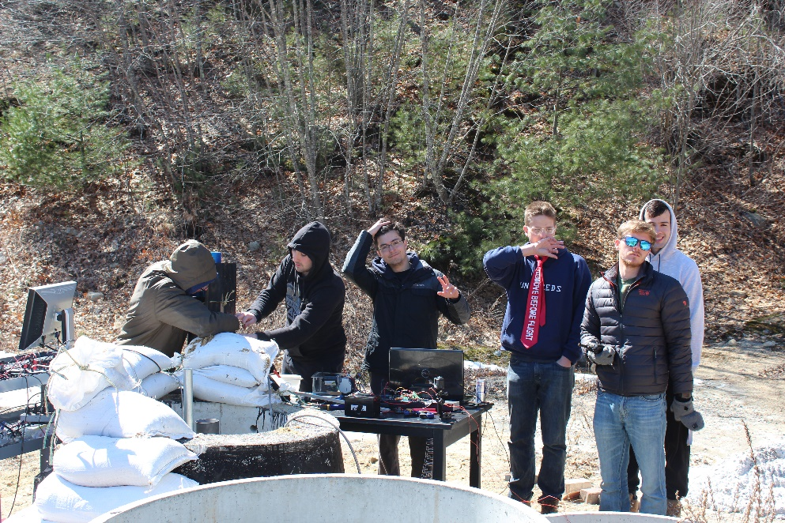
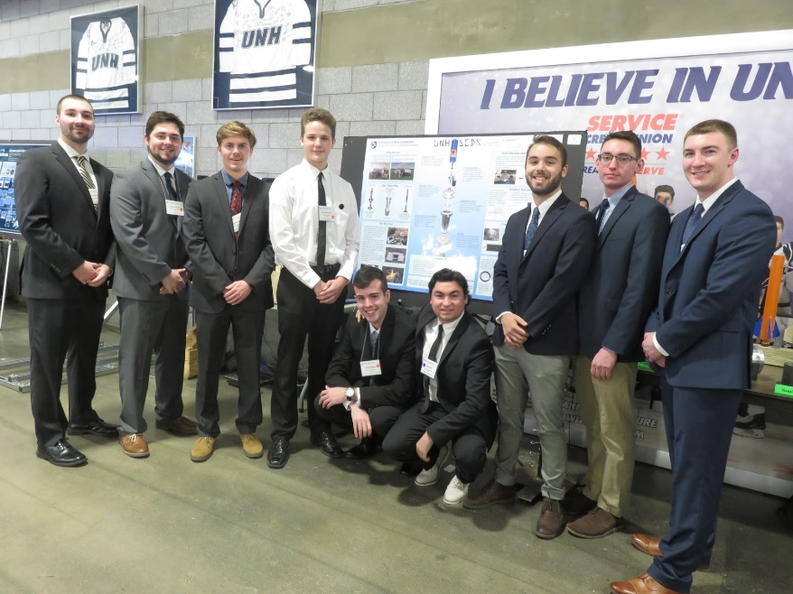
What is UNH SEDS?
UNH SEDS (Students for the Exploration and Development of Space)
Rocketry Organization
Founded 2017
Competing in Spaceport America Cup 2020 in New Mexico
University of New Hampshire
Students for the Exploration and Development of Space
Notes:
Seds is a naitionwide organization that allows colleges from around the world to start a chapter. Although we are allowed to do whatever we would like as an organization, they do sponsor competition for SEDS groups as well as national conferences, the next one for the beginning of November. We are a team comprised of many majors and all classes, so applying to join our team would not only be a senior project, but an interdisciplinary experience.

Slide 4







Project Overview
Students for the Exploration and Development of Space (SEDS)
Third year organization
Design and test a hybrid rocket
Applying rocket mechanics from last two years knowledge
Research gimbal control of rocket engines
Spaceport America Cup - June 2020 in Las Cruces, New Mexico
10,000 ft. altitude student researched and developed hybrid class
Target apogee 10,000 feet
Build, test, analyze, optimize
University of New Hampshire
Students for the Exploration and Development of Space

Slide 5
Senior Design
Mission Control Rolling Bunker
University of New Hampshire
Students for the Exploration and Development of Space

Slide 6
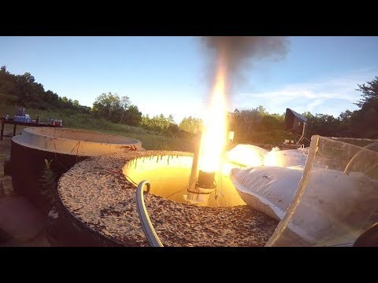

Slide 7
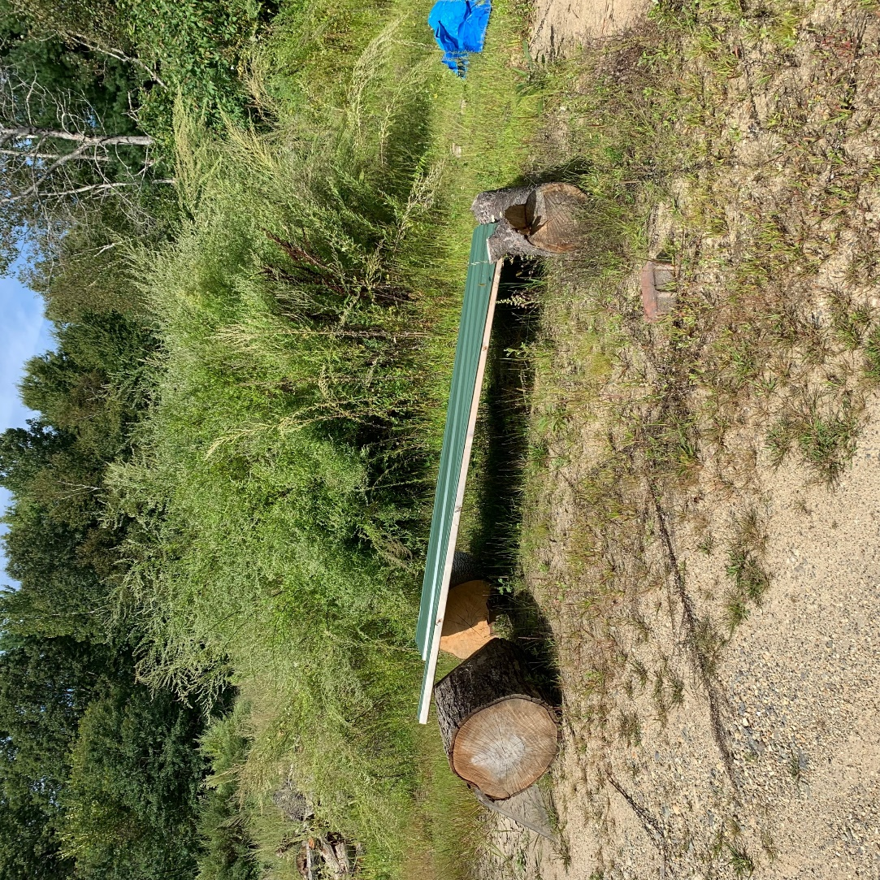
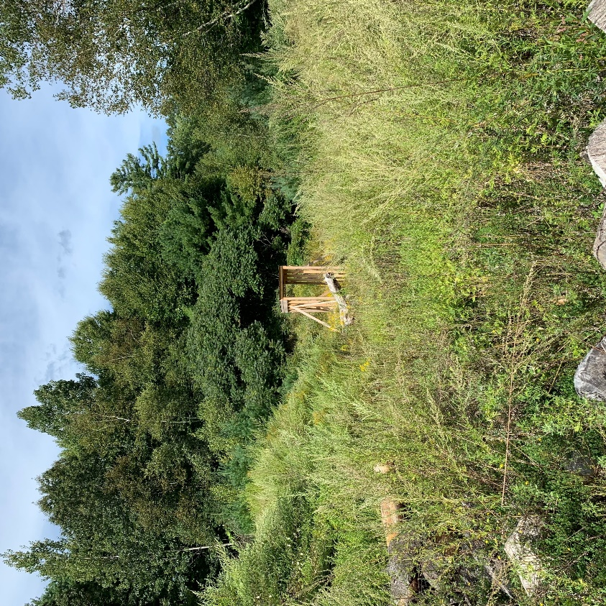
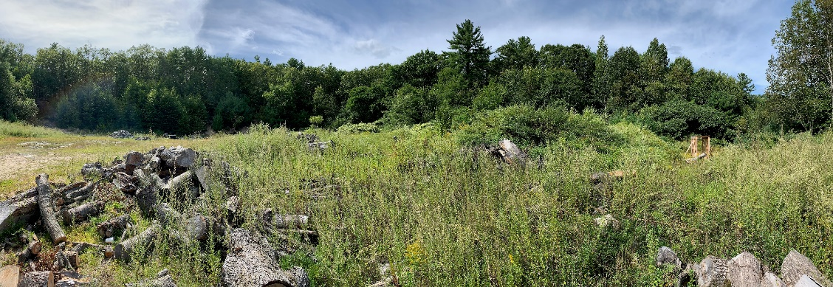
What we have to protect us… and the structures for reliable testing procedures
University of New Hampshire
Students for the Exploration and Development of Space

Slide 8
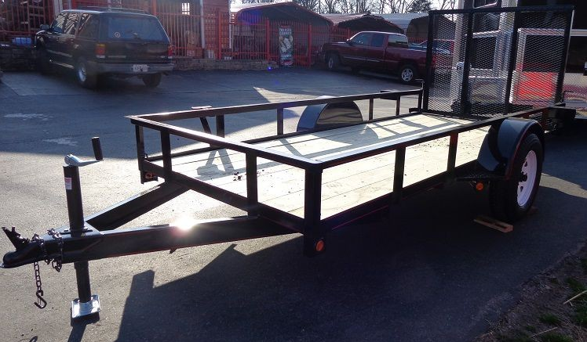
What we need…
A bunker that can withstand an impact from a failed rocket engine test
A bunker with the ability to hold 8-10 people
A bunker that can be trailered from the back of a pick up truck
The aft section used for mission control
University of New Hampshire
Students for the Exploration and Development of Space

Slide 9
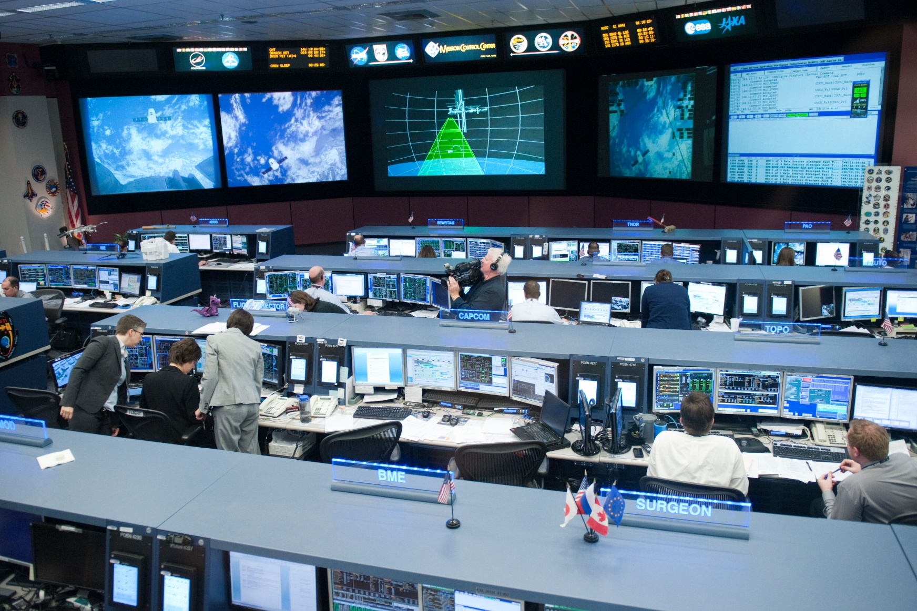
What we want…
University of New Hampshire
Students for the Exploration and Development of Space

Slide 10
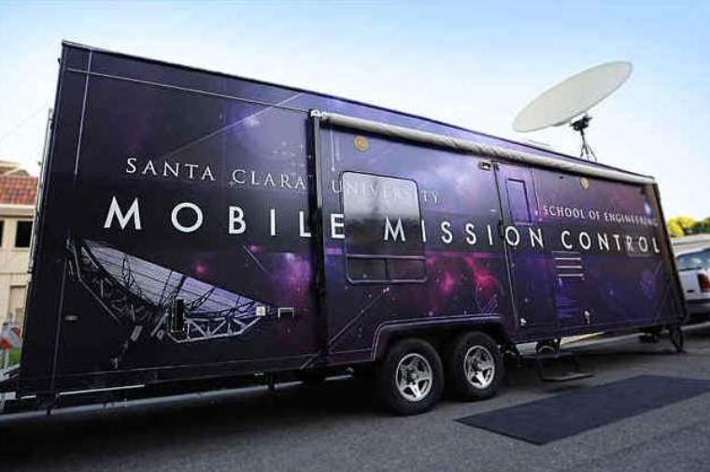
What we actually want…
A bunker that is heated for winter tests
A live feed of the test site during hot fire tests displayed through a TV in bunker
A self sustaining bunker powered by renewable energy with battery storage
Note: Will have the support of amazing EE’s ME’s and CS when needed.
University of New Hampshire
Students for the Exploration and Development of Space

Slide 11
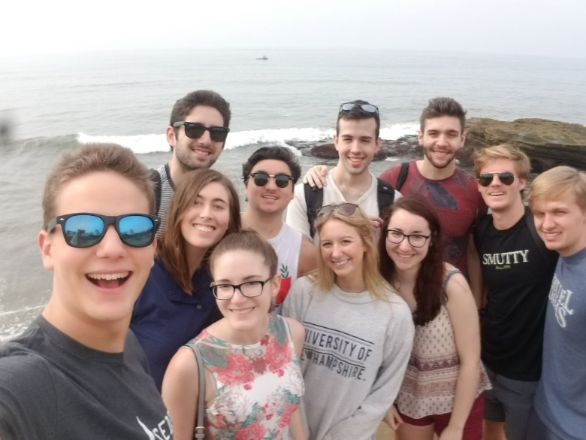
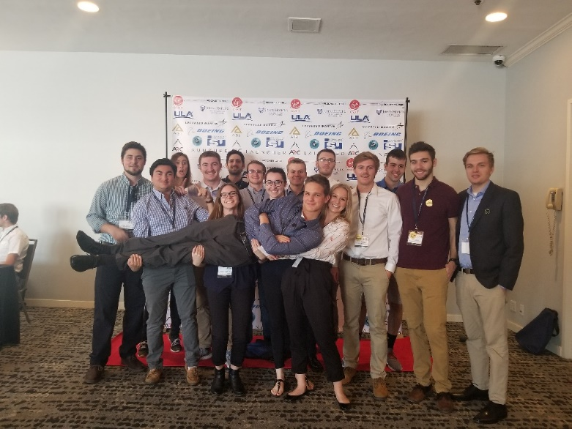
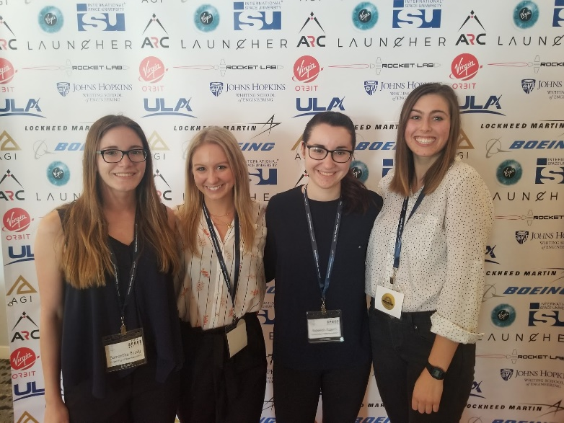
SpaceVision
SEDS USA hosts a national conference every year called ‘SpaceVision’ where many of the various SEDS chapters congregate to network and listen to speakers. This year, it will be on November 2019 in Arizona State University. We brought 16 of our members to take part in the 2018 SpaceVision located in San Diego California.
University of New Hampshire
Students for the Exploration and Development of Space
Notes:
EE major too

Slide 12
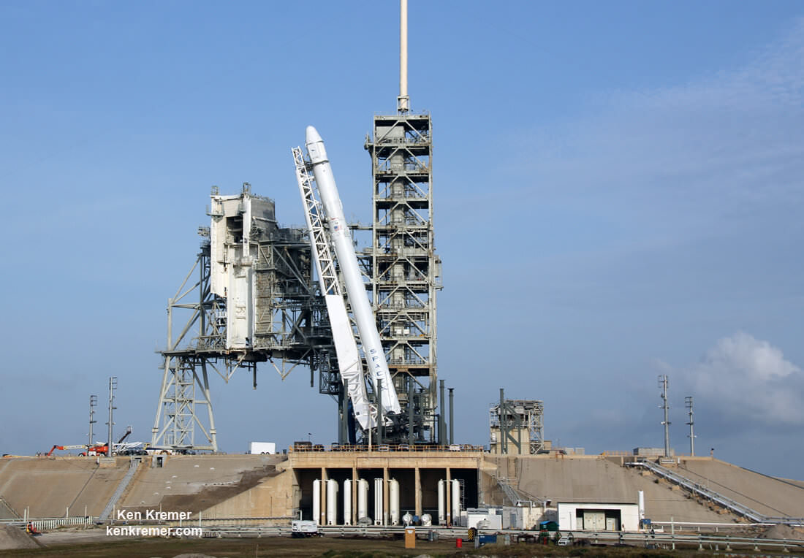

Careers for Civils in Commercial Space
SpaceX Cape Canaveral
Rocket Lab New Zealand
University of New Hampshire
Students for the Exploration and Development of Space
Notes:
EE major too

Slide 13
Future Obstacles/ Challenges
Completion of our hybrid rocket engine
Complete integration of all electronic / avionic parts into a rocket
Gimbal System / Thrust vectoring
Safety!
University of New Hampshire
Students for the Exploration and Development of Space

Slide 14
Questions?
University of New Hampshire
Students for the Exploration and Development of Space

Slide 15

Interested SEDS as your senior project?
Stop by Kings S172
Or
E-mail Charlie Nitschelm at cjn1012@wildcats.unh.edu
Name
Why are you interested in joining SEDS?
Contact ASAP – already started
University of New Hampshire
Students for the Exploration and Development of Space

